Slide 1
Implicit and Explicit Techniques for Space
Elevator Simulation
Blaise Gassend, PhD, PE
ISEC 2026
https://gassend.com/spaceelevator/isec2026
https://doi.org/10.5281/zenodo.22736736
1

Slide 2
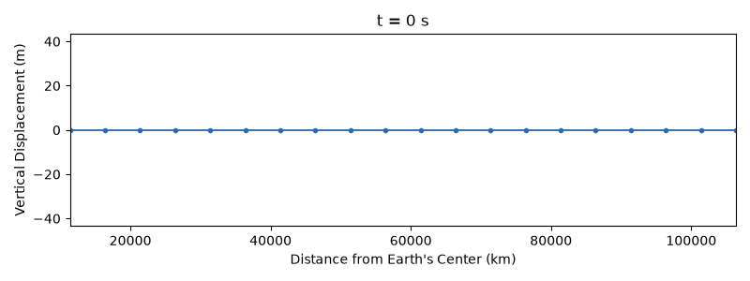
Simulating a Tether Is Easy!
When you set out to simulate a space elevator, the most natural approach is to
represent the elevator using a mass and spring model.
Within an hour -- 5 minutes with AI -- you can be looking with satisfaction at a nice
simulation of the space elevator's tether.
Note: 1-D simulation with only up-down motion, integrated using Forward Euler.
2

Slide 3
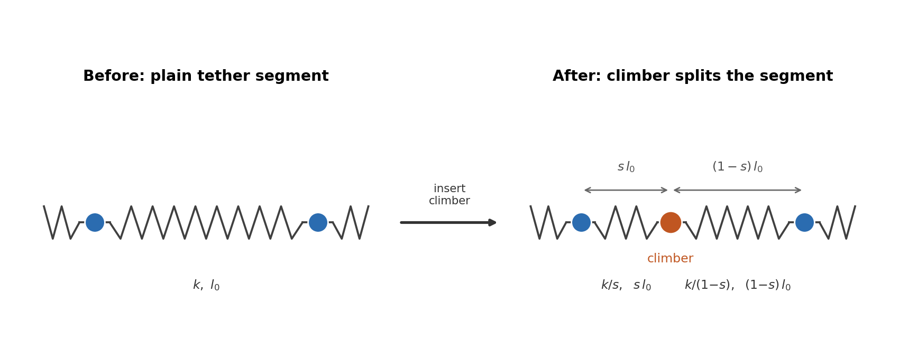
Adding the Climber
To add a climber, the natural approach is to replace the spring that the climber is located on
with two springs whose stiﬀness and length depend on how far along the climber is.
3

Slide 4
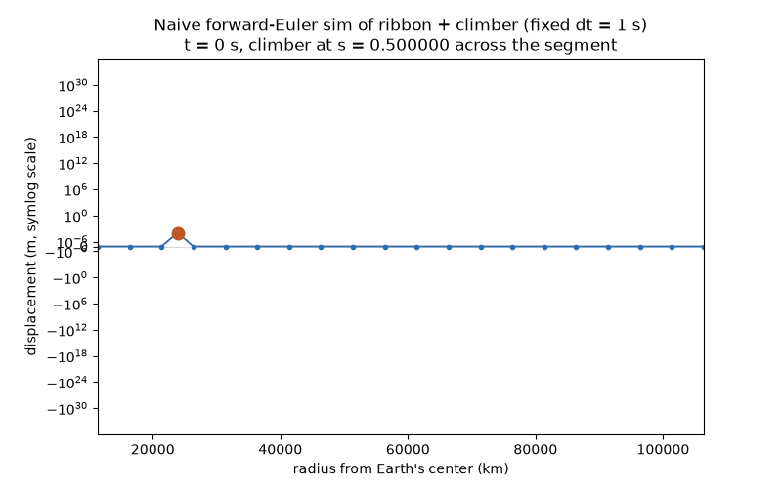
Climbers Make Things Harder!
Unfortunately, the simulation now blows up.
4

Slide 5
About This Presentation
These slides were heavily produced with AI assistance (Claude).
The underlying ideas have been thoroughly vetted by the author.
The ﬁgures are illustrative and may contain inaccuracies -- the code behind them was
not checked in detail.
Many simulations shown are 1-D, modeling only the vertical (longitudinal) direction, for
simplicity.
The integrators shown mostly use basic explicit/implicit Euler for simplicity of
exposition -- the same stability eﬀects occur with higher-order methods (RK4, etc.);
Euler just makes the story easiest to see.
The underlying numerical-methods material itself isn't very novel -- it's standard stiﬀ-
ODE theory. What's novel here is applying it explicitly to space-elevator tether and
climber dynamics. The goal is to help the SE simulation community understand and get
past this common pain point.
5

Slide 6
Coming Up
1. Why the blowup happens
2. What have people been doing about it
3. Implicit methods
4. Why the blowup really happens
5. IMEX method
6

Slide 7
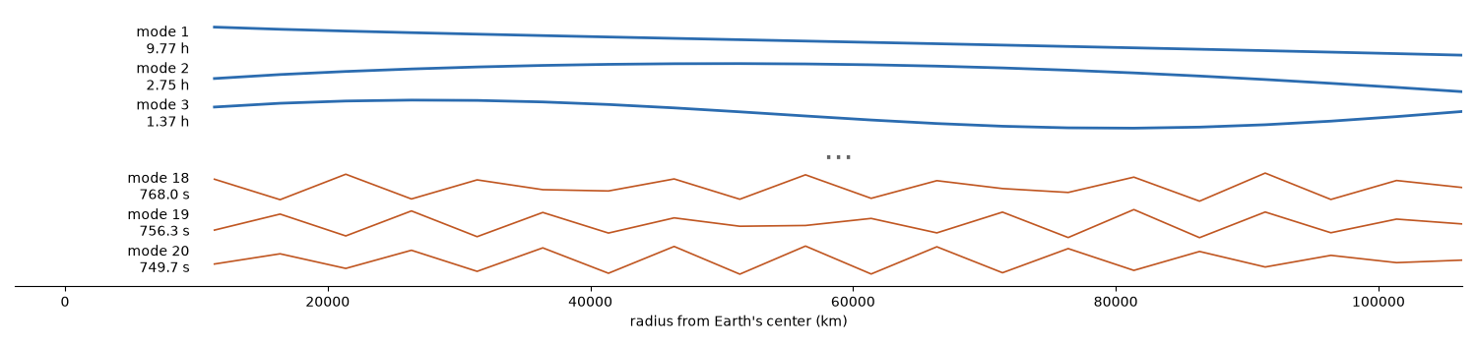
System Modes
A system near equilibrium can be linearized.
The linearized system is equivalent to a collection of independent harmonic oscillators,
possibly damped.
The low frequency modes are typically a good representation of the real system.
The high frequency modes usually are not a faithful representation.
7

Slide 8
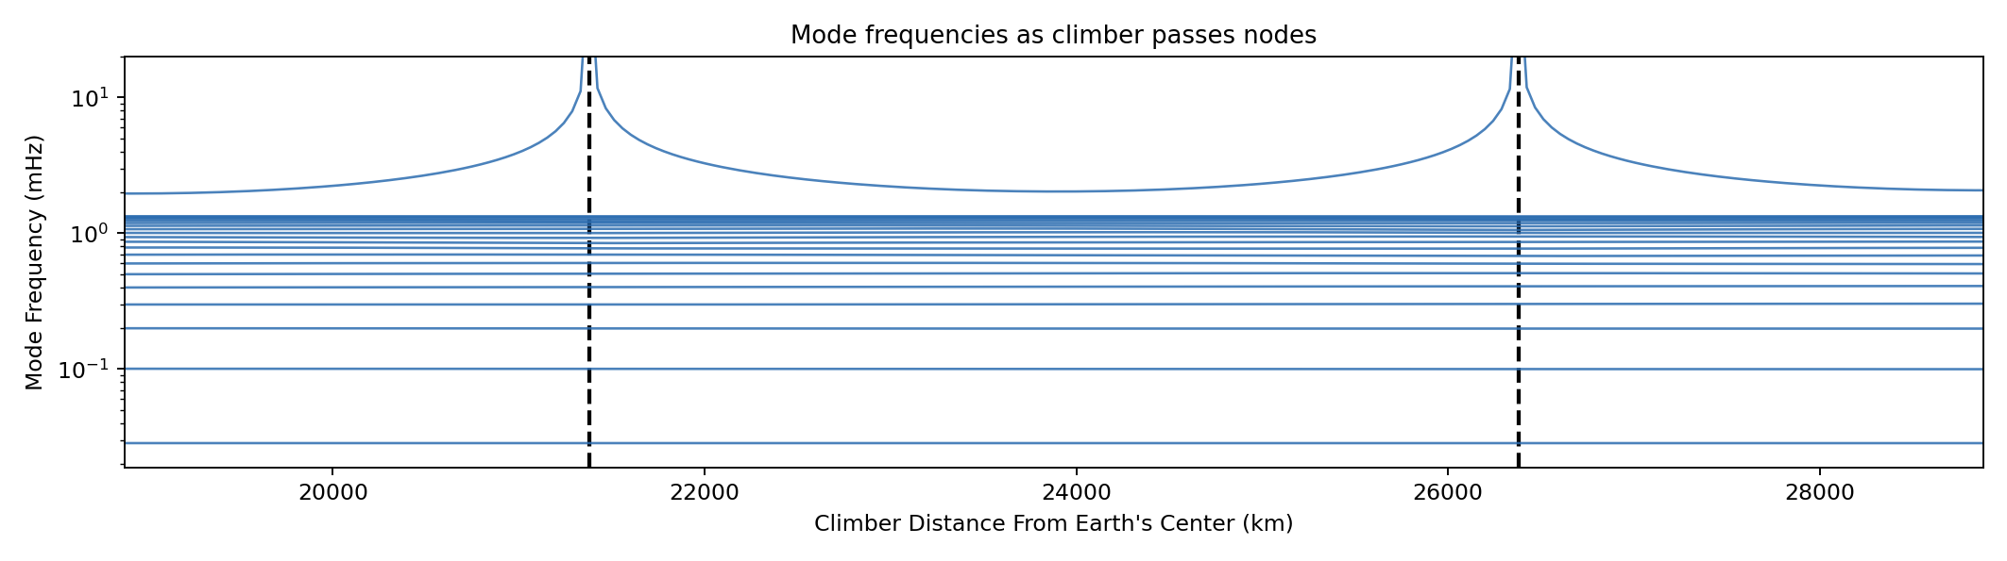
Mode Shift As Climber Moves
As the climber approaches a node (
), the short spring stiﬀness
diverges.
As a result, the highest frequency mode approaches inﬁnity.
The system becomes stiﬀ.
8

Slide 9
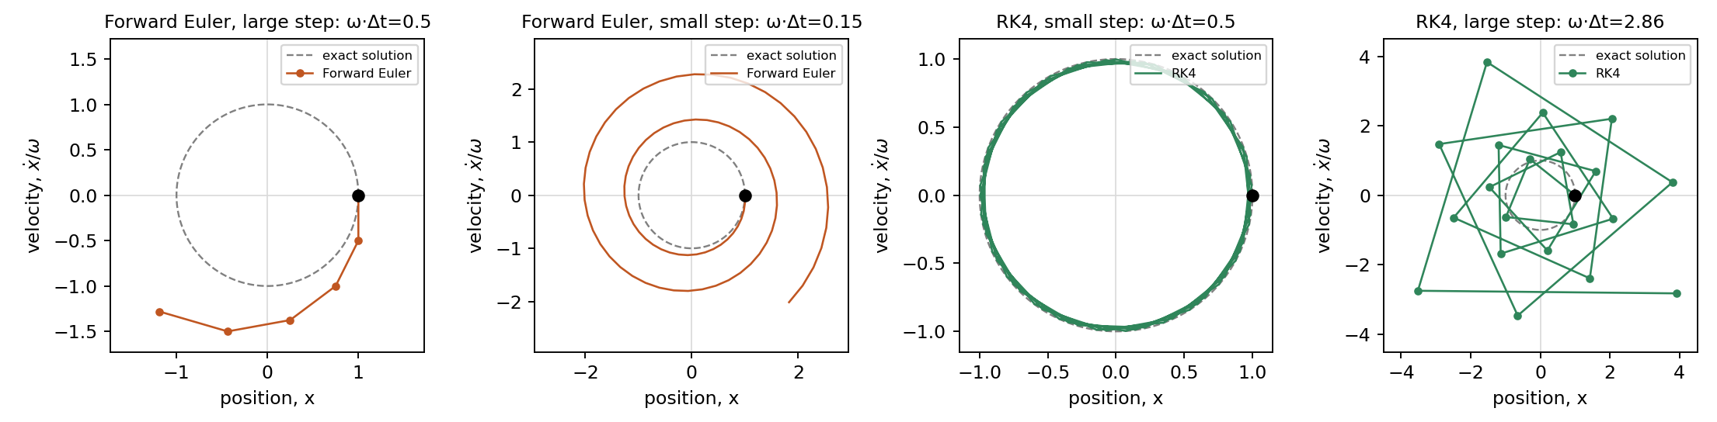
Explicit Methods Divergence
The simplest simulation methods to implement are called explicit.
You use derivatives from past times to compute state variables at future times.
Forward Euler:
Explicit methods diverge for
too large compared with the frequency of the mode being simulated.
Mystery solved! The naive climber simulation diverges because the highest frequency diverges.
9

Slide 10
How People Have Been Taming the Divergence
Add/drop nodes: as climber approaches node, drop node, then reinsert as the climber moves away.
Unclear where to put the mass of the dropped node. Can't get right to the surface of the Earth.
Dropping a node changes DOF count, losing mode energy -- not a problem. But also distorts modes.
Resample the tether: re-discretize node placement as the climber moves to avoid closely approaching node.
Inter-node spacing more uniform. But complex. Still need add/drop or you get large variation in node
spacing with time (unnecessarily small
). Still can't deal with climber right at Earth surface.
Resampling damps the high frequency mode. Not a problem.
Connect the climber to its attachment point via a spring: avoids inﬁnite stiﬀness when passing tether
nodes.
Sudden attachment point velocity change introduces spurious impulses in the tether.
Climber can oscillate relative to attachment point. High frequency, not a problem.
10

Slide 11
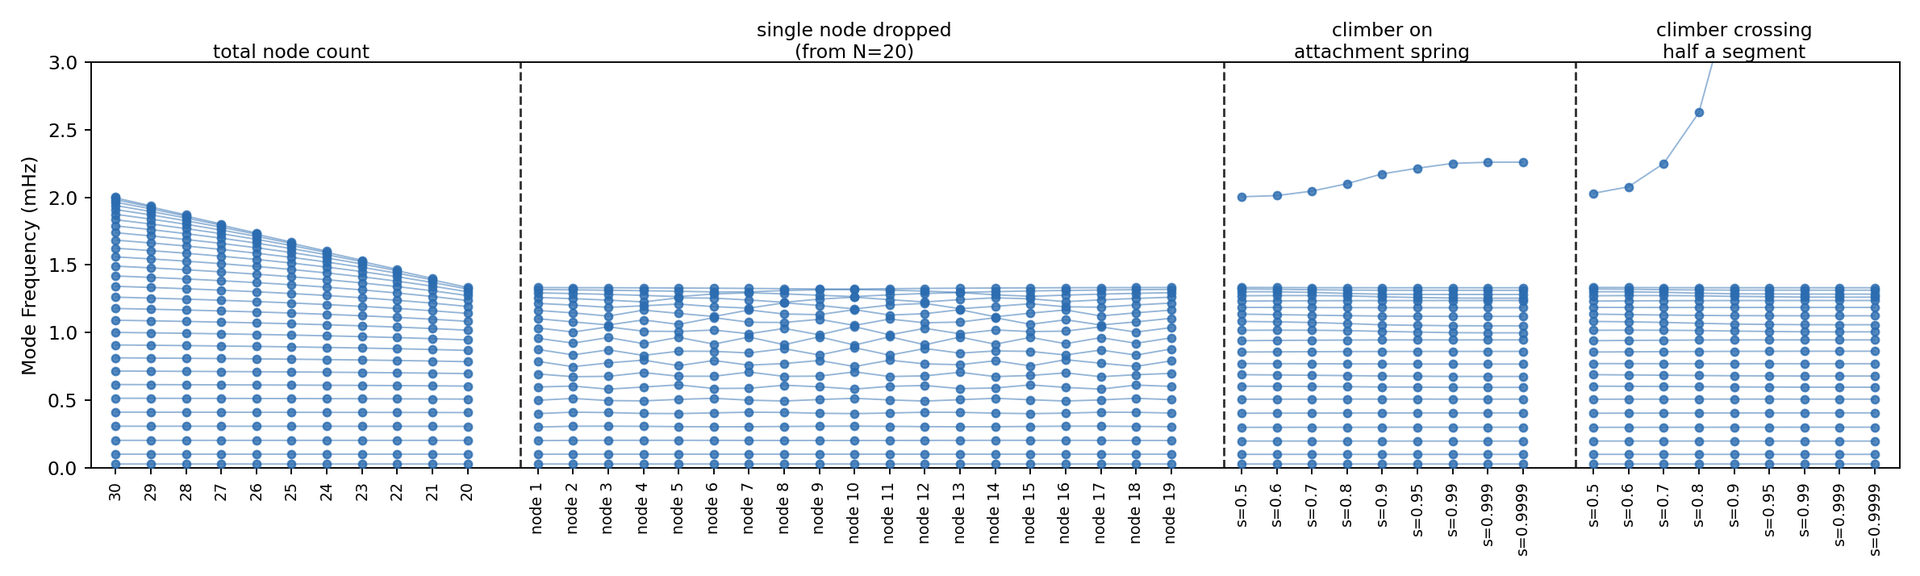
Eﬀect of Modiﬁcations on Modes
Low frequencies remain unchanged when resampling with diﬀerent numbers of nodes (left) or an extra
spring (center-right). Adding/dropping a node (center-left) is more disruptive to the mode frequencies.
Unmodiﬁed model is shown for comparison (right). Mode 1 stays within 0.02841-0.02844 mHz throughout.
Modiﬁcations have limited impact on accuracy, as long as there are enough nodes to push the impacted
modes to irrelevant high frequencies. Resampling and climber attachment via a spring outperforms
adding/dropping nodes.
11

Slide 12
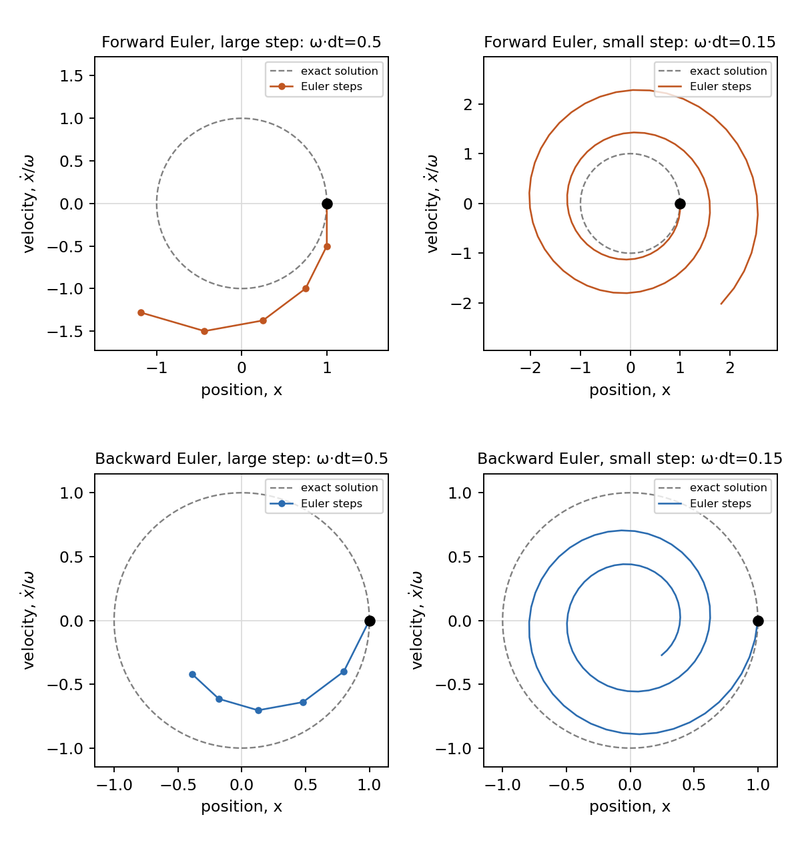
Implicit Integration: Pay per Step, Choose Your Bandwidth
Implicit methods compute the state variable
at future times by using derivatives from
future times.
Backward Euler:
To compute
you need to already
know it. How does that work ???
Iteratively solve for
-- this is slow.
Doesn't explode, but it is no more accurate.
So, why would you do this?
12

Slide 13
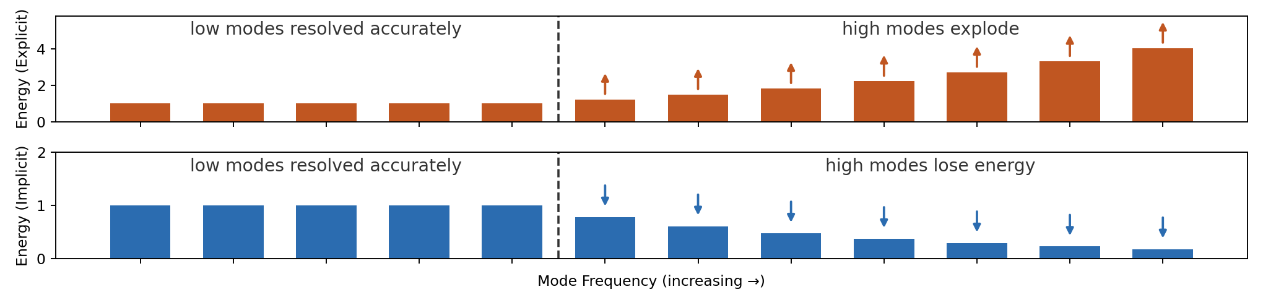
Beneﬁt of Implicit Methods
Explicit methods force you to use a time step that matches the fastest mode (stiﬀest
degree of freedom). Simulation may be very slow.
Implicit methods allow you to select the fastest mode you care to model accurately.
Fast modes will decay and be inaccurate, but will not blow up the simulation.
13

Slide 14
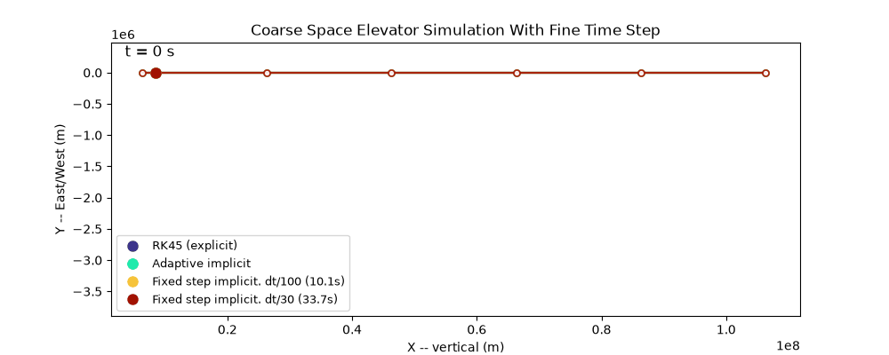
Very Precise Solution of Spatially Coarse Model
Solve a very coarse 3D SE model using Explicit and Implicit adaptive solvers, as well as with ﬁxed time steps.
Surprisingly, they all agree on the result, suggesting that all these methods have managed to accurately solve
the model, despite the divergence, even using an explicit RK45 method.
Downward jumps because climber gets deﬂected to the side as it approaches node.
14

Slide 15
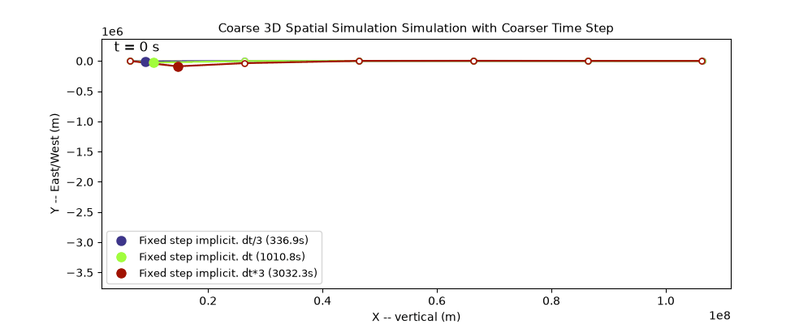
Coarser Solution
With larger time steps, the unphysical jumps go away completely! Good agreement over 10x step size
variation. Climber hops over nodes, may be good to phase climber motion to voluntarily miss nodes.
The large step size is heavily damping the diverging mode, allowing us to get a more physically accurate
result. Mystery really solved! The discretized model was ﬂawed if solved accurately.
15

Slide 16
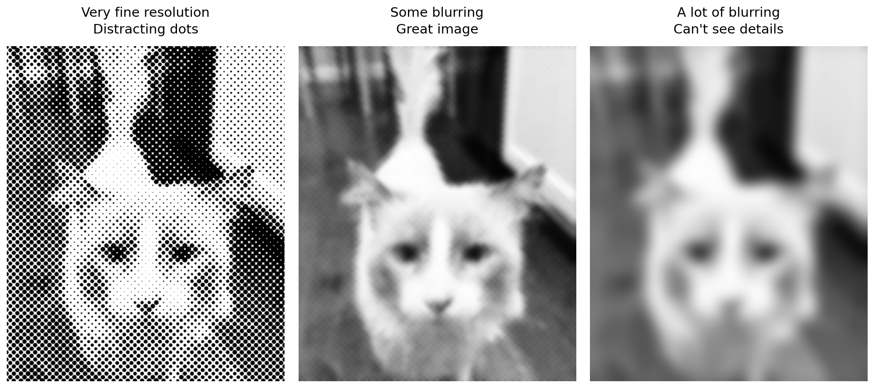
Another Beneﬁt of Implicit Methods
Beneﬁt 1: Implicit methods allow simulation of stiﬀ systems without needing small time steps.
Beneﬁt 2: A solver that heavily damps unphysical high frequency modes may produce a solution that better
matches the non-discretized system. A perfect integration of the discretized model gives garbage. A less
perfect integration gives good results. Analogy with image focus:
16

Slide 17
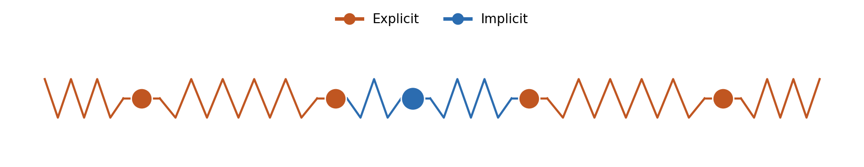
Faster Simulation with Implicit-Explicit (IMEX) Methods
Split the derivative into two parts, one explicit, one implicit. (Higher order methods are available.)
IMEX Euler:
You still need to solve an equation, but if
is simple, that equation may be fast to solve.
For the space elevator simulation:
climber, all forces acting on it, and their reactions in
everything else in
Implicit step equivalent to solving the climber position with the tether frozen in place. Small, fast system of
equations.
17

Slide 18
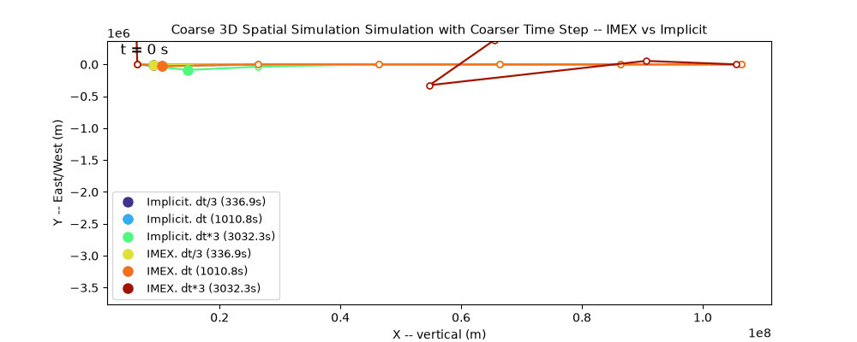
Imex coarse simulation
The IMEX method gives the same result as the implicit method, but has more challenges with stability,
especially with coarser time steps.
18

Slide 19
Takeaways
Climbers approaching tether nodes in a ball and spring simulation break the simulation in two ways:
Explicit solvers may go unstable due to the high frequency mode.
Exactly solving the model seems to have unphysical behavior.
So far, we have focused on avoiding these problems by changing the discretization to avoid high stiﬀness,
adding complexity and not always fully correcting the problem.
Instead we can keep the naive discretization and select a suitable implicit solver.
Choose
based on the modes that need to be accurate, and the modes that need to be excluded from
the simulation.
Higher
modes, which are at best not accurate, and at worst introduce pathological artifacts, will get
damped away without harming the simulation.
But simulation time may be slow because of large systems of equations to solve repeatedly.
An IMEX method can be a lower computation load approach to getting rid of the highest frequency mode
that causes climber jumps when passing nodes. But you still need to capture all the other high frequency
modes so smaller time steps are needed than for fully implicit.
19

Slide 20
Q&A
20

